Slide 1
Grub, Devices, and partitions

Slide 2
What is a bootloader?
A bootloader allows the user to choose what os they want to load into on their machine. It is necessary to boot into your computer.
Runs startup processes (ie LightDM to start GUI)

Slide 3
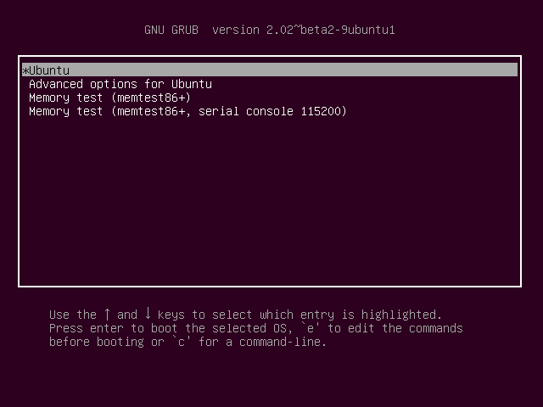
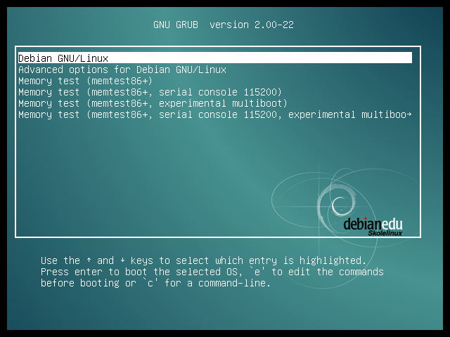
Then what is grub?
GRUB stands for Grand Unified Bootloader
It looks like this --->

Slide 4
So where and how do we configure GRUB?
GRUB has a couple of locations where we can add configurations
/etc/default/grub is the main config file
/etc/grub.d/ this is probably the more useful config files will be tho

Slide 5
Here is a simple config
#!/bin/sh
exec tail -n +3 $0
# This file provides an easy way to add custom menu entries. Simply type the
# menu entries you want to add after this comment. Be careful not to change
# the 'exec tail' line above.
set check_signatures=enforce
export check_signatures
#define superusers
set superusers="root"
export superusers
#define users
password_pbkdf2 root grub.pbkdf2.sha512.10000.TODO
We are editing the /etc/grub.d/40_custom file
Line by line
Set check_signatures=enforce
Enforces that GRUB checks the signature of any boot file before booting into it
Set superusers=”root”
Sets superuser list, DOES NOT HAVE TO MATCH ACTUAL IMAGE, can be any username u want
Password_pbkdf2
Sets password of superuser to password in sha512 hash

Slide 6
Quick tips
Sudo grub-mkpasswd-pbkdf2
Works like passwd, but instead generates a password in grub SHA512 format for you to use in grub config
Sudo update-grub
Applies all changes to grub from /etc/default/grub.

Slide 7
What is a device in Linux?
Device files are files that represent whole disk drives which allows us to use them as if they were regular files, simplifying many tasks.

Slide 8
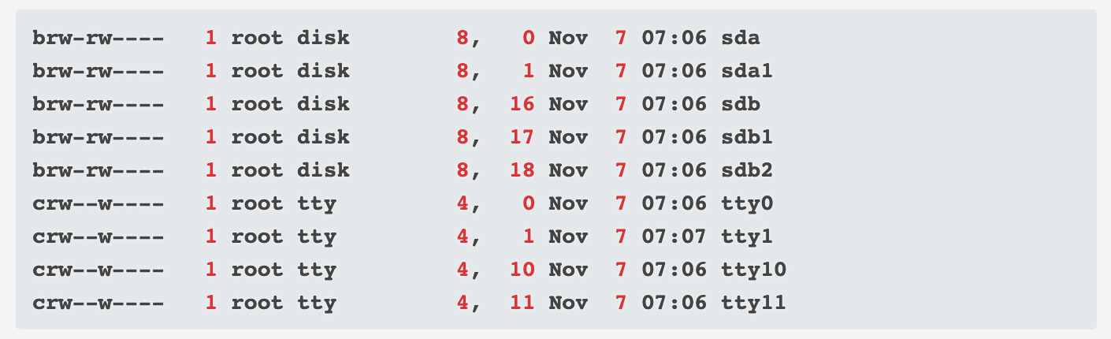
Where are device files stored?
Device files are stored in the /dev/ directory
Device files are really in depth, and this is a light coverage of them, add this to your list of things to study.

Slide 9
Commands to make use of Devices
dd if=/dev/{dev u want to read} skip={byte u want to start at} count={how far to go}
if you wanted to read sda1, looking for data in bytes 3000 to 3020 it would look like:
dd if=/dev/sda1 skip=3000 count=20

Slide 10
What is a partition?
A partition is a segment of a HDD, while you can install an OS on one single HDD, there are benefits to doing it across multiple partitions
You can install multiple OSes on a HDD
Filesystem corruption is limited to one partition, so you can avoid losing a whole drive
You can prevent runaway processes from consuming the whole HDD

Slide 11
Commands related to a partition
df -h
check data usage on filesystem and partition(s)
mount /dev/sda[#]
mount a partition
umount /dev/sda[#]
unmount a partition
fdisk /dev/sda
partition the SDA device, interactive. Press N for new part, d to delete a part, or p to print a table with all partitions

Slide 12
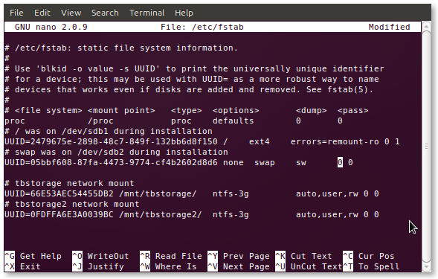
What is /etc/fstab
Your fstab is your system’s file system table
should look similar to this but not exactly the same

Slide 13
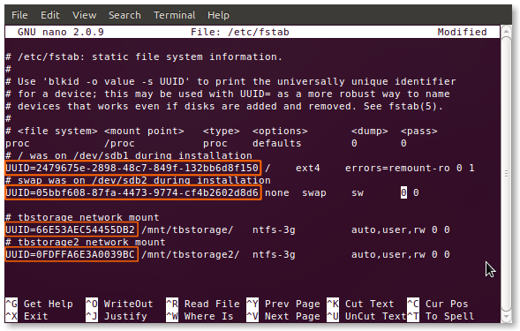
UUID - Unique universal identifier, This is the unique ID that cannot be changed, system will take this to the grave can be used to call upon a specific file system to partition instead of the generic device file.
.

Slide 14
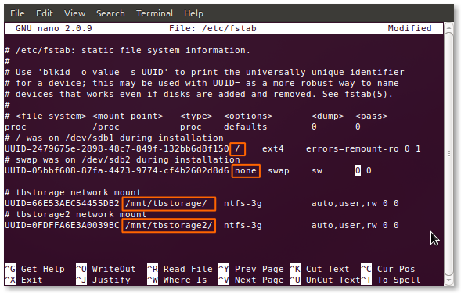
Mount point - this is where the filesystem is mounted, where you can access the files stored on this device.

Slide 15
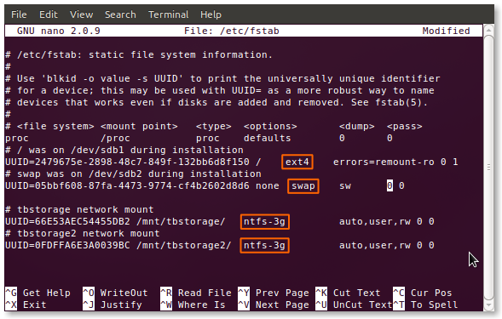
Type- Type of filesystem used, ext4,ext3, swap, and many others are supported natively. Ones like ntfs require drivers like ntfs-3g

Slide 16
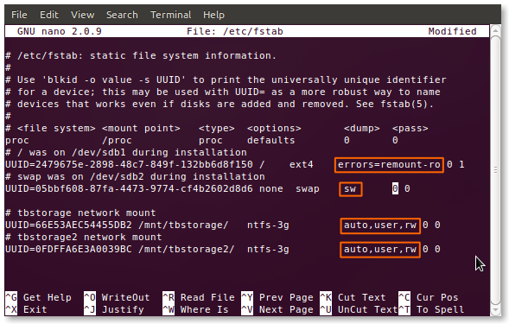
Options- various modifiers and permissions on a drive. Move on to next slide to see some important options

Slide 17
fstab options
auto/noauto: Specify whether the partition should be automatically mounted on boot. You can block specific partitions from mounting at boot-up by using “noauto”.
exec/noexec: Specifies whether the partition can execute binaries. If you have a scratch partition that you compile on, then this would be useful, or maybe if you have /home on a separate file system. If you’re concerned about security, change this to “noexec”.
ro/rw: “ro” is read-only, and “rw” is read-write. If you want to be able to write to a file-system as the user and not as root, you’ll need to have “rw” specified.
nouser/user: This allows the user to have mounting and unmounting privileges. An important note is that “user” automatically implies “noexec” so if you need to execute binaries and still mount as a user, be sure to explicitly use “exec” as an option.
suid/nosuid - Permit/Block the operation of suid, and sgid bits.
defaults - Use default settings. Equivalent to rw, suid, dev, exec, auto, nouser, async.
tmpfs /run/shm tmpfs defaults,nodev,noexec,nosuid 0 0
tmpfs /tmp tmpfs defaults,rw,nosuid,nodev,noexec,relatime 0 0
tmpfs /var/tmp tmpfs defaults,nodev,noexec,nosuid 0 0

Slide 18
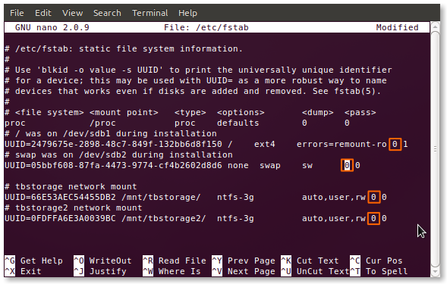
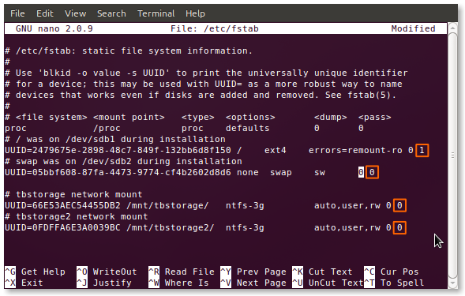
Dumping and passing - The first number stands for dumping, as a general rule set dumping to 0, the second number is passing, which checks drives for errors, ALWAYS HAVE ROOT as 1.
Notes:
Dump cmd is used to backup files from a filesystem
Passing refers to fsck, checking what mounting points have programs for startup

